Slide 1
CSE431 ( NATURAL LANGUAGE PROCESSING-1 )
Task 2 Team 16
Members:
Ishrat Tasnim Awishi
20301031
Section 2
Niloy Farhan
20101118
Section 2

Slide 2
Improving Document-Level Sentiment Classification Using Importance of Sentences
Gihyeon Choi, Shinhyeok Oh and Harksoo Kim

Slide 3
What is Sentiment Analysis
Sentiment analysis is the process of computationally identifying and classifying opinions stated in a piece of text, particularly to identify the polarity of the writer towards a given topic, product, etc.
It is often modeled as a classification problem which relies on features extracted from the text in order to feed a classifier.

Slide 4
Previous Works
Lexicon based / Rule based:
The manual construction of sentiment lexicons
Drawbacks:
1. Time consuming and Labor intensive
2. Same word can have different polarities.
Example: The air conditioner is so hot. ( hot = negative polarity)
The movie is so hot. ( hot = positive polarity)

Slide 5
Previous Works
Machine Learning & Deep Learning based model:
Used CNN, RNN, BERT to classify sentiments.
These showed good performance in classification tasks.
Previous document level classifiers considers the text as a bag of sentences without evaluating the importance of each sentence.
These model cannot consider how much each sentence contributes in determining the polarity of a given document.

Slide 6
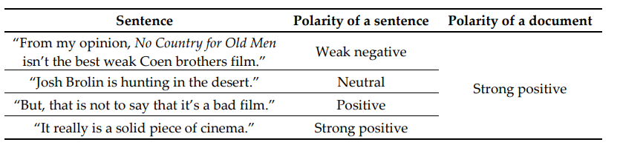
Proposed Model
The author proposed a new model which gives attention to the polarity of each sentences

Slide 7
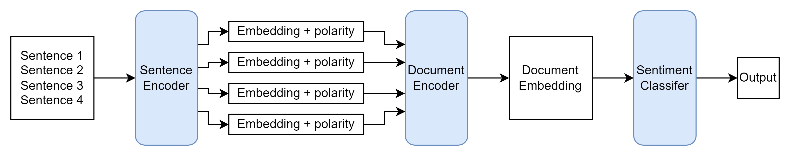
Proposed Model Architecture
Three submodules:
Sentence Encoder
Document Encoder
Sentiment Classifier

Slide 8
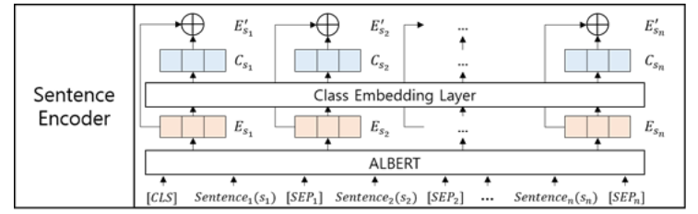
Sentence Encoder
Converts each input sentence into embedding vectors using ALBERT.
Predicts the polarity of each sentences.
Using weights of each classes, it generates a Class Similarity Embeddings
Finally, concatenates ALBERT embedding and Class Similarity Embeddings of each sentences

Slide 9
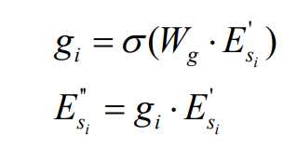

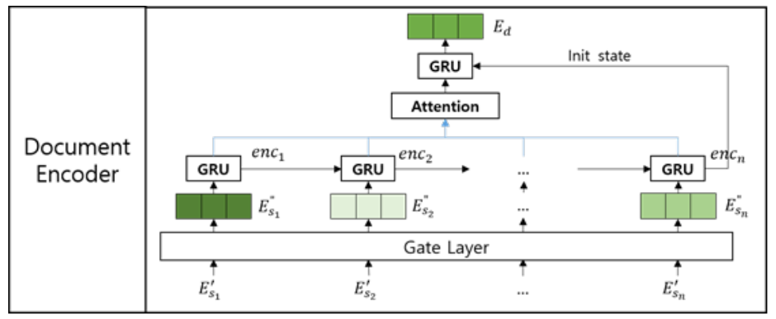
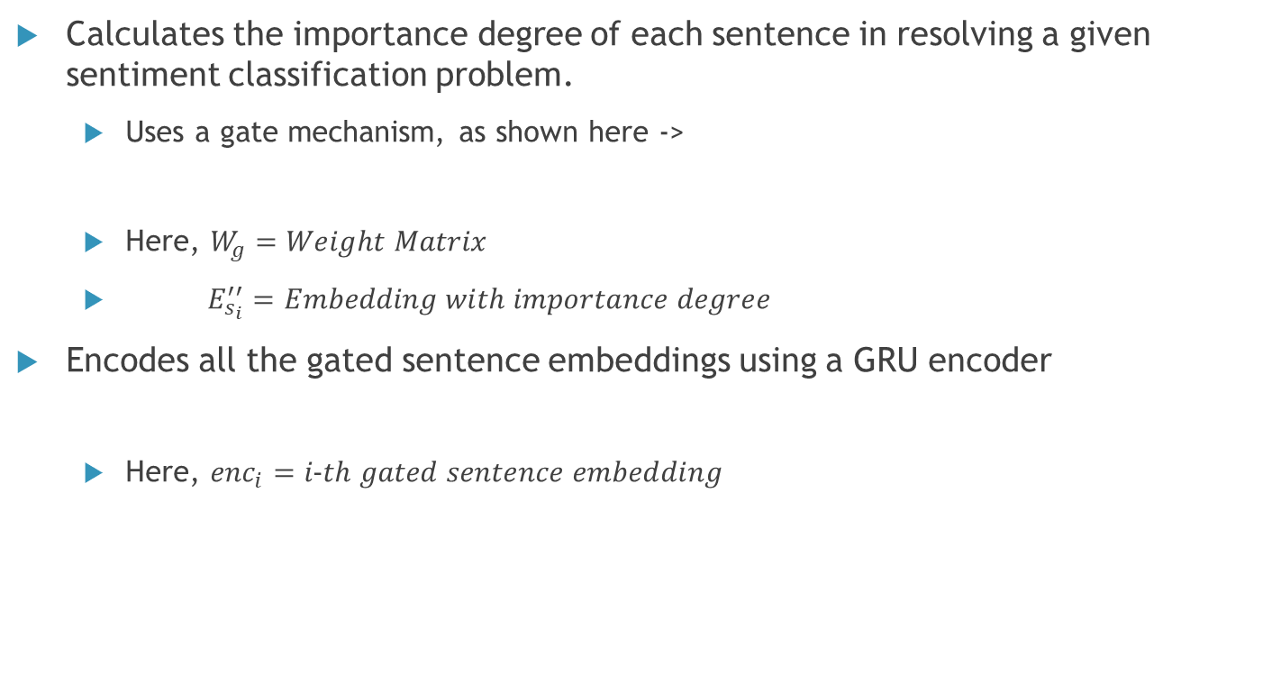
Document Encoder
Calculates the importance degree of each sentence in resolving a given sentiment classification problem.
Uses a gate mechanism, as shown here ->
Here, $W_{g}=Weight Matrix$
$E_{s_{i}}^{′′}=Embedding with importance degree$
Encodes all the gated sentence embeddings using a GRU encoder
Here, ${enc}_{i}=i-th gated sentence embedding$
Notes:
The document encoder is the second submodule of the proposed architecture.
It takes the embedding provided by sentence encoder and gives us a document embeddings.
At first ….
Gated recurrent units are a gating mechanism in recurrent neural networks, introduced in 2014 by. The GRU is like a long short-term memory with a forget gate.

Slide 10
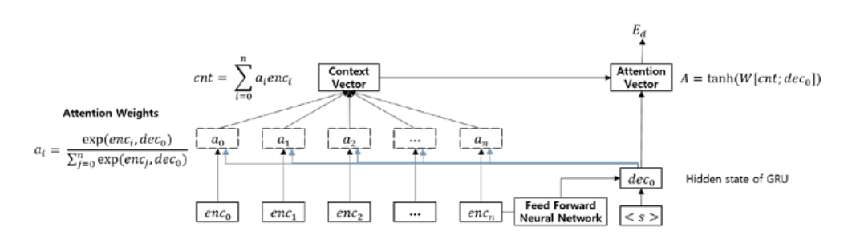
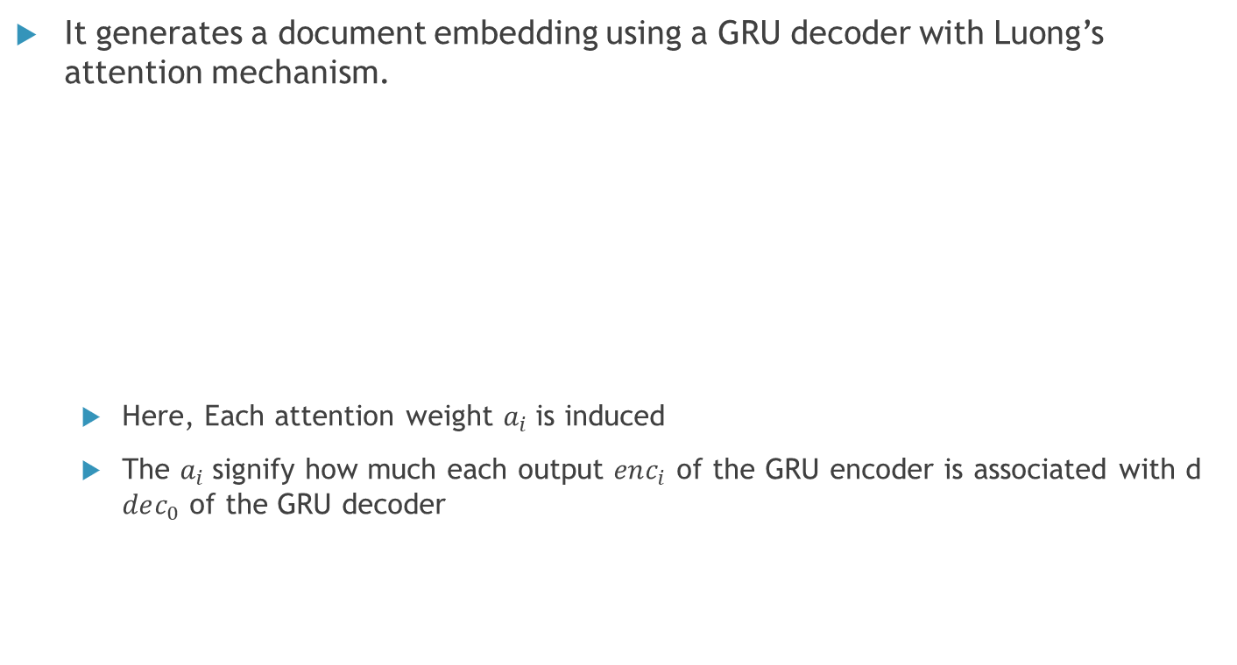
Document Encoder
It generates a document embedding using a GRU decoder with Luong’s attention mechanism.
Here, Each attention weight $a_{i}$is induced
The $a_{i}$signify how much each output $enc_{i}$ of the GRU encoder is associated with d $dec_{0}$ of the GRU decoder
Notes:
A_i calculated by inner products between each output $enc_{i}$ of the GRU encoder and the first hidden state $dec_{0}$of the RNN decoder

Slide 11

Document Encoder
The context vector $cnt$ is constructed by the weighted sum of $a_{i}$and $enc_{i}$
$cnt= \sum_{i=0}^{n}{{ a}_{i}enc_{i}}$
Finally, the RNN decoder generates a document embedding as expressed by the following equation:
$E_{d}=GRU(FNN\left(enc_{n}\right), <s>, cnt)$

Slide 12

Sentiment Classifier
Determines the sentiment class of an input document.
Uses the document embedding and a class similarity embedding as inputs
Made with Fully connected Neural Network (FNN) with sigmoid output function as below:

Slide 13
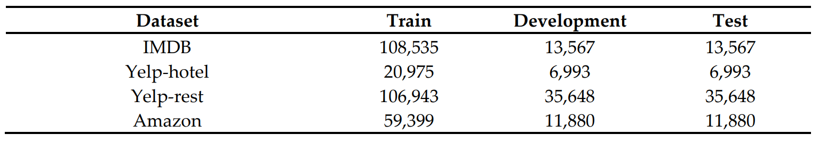

Experiment and Results
Dataset: IMDB, YELP-hotel, YELP-rest, Amazon
Sentence segmentation: NLTK library of python
Model implemention: PyTorch
Metric used:

Slide 14
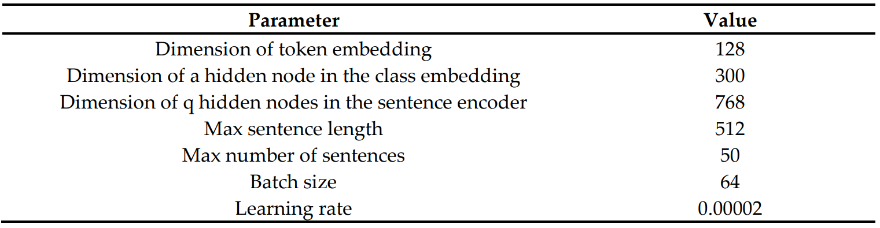
Experiment and Results
Optimal Hyperparameters:

Slide 15
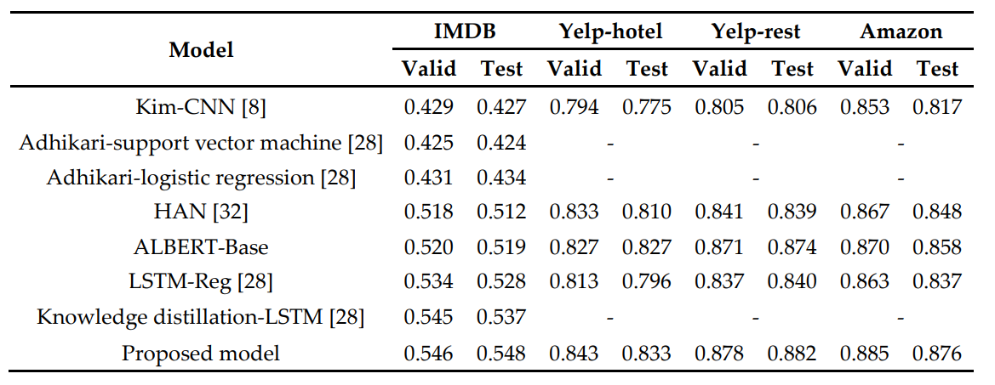
Experiment and Results
Performance comparison with previous models
The proposed model outperformed all the previous sentiment classification models in the experiments with all the datasets.

Slide 16
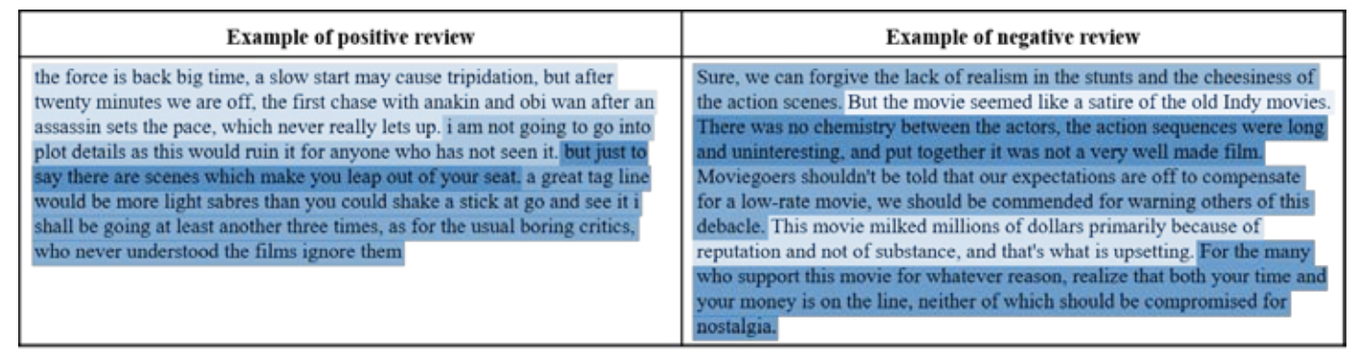
Conclusion
Proposed an effective neural network model for document-level sentiment classification.
Proposed model automatically determines the importance degrees of sentences in documents using gate functions learned from mass training data. For example:

Slide 17
Thank you

